Slide 1
Community Dialogue 2019
The Health of our Communities
Chisago County, MN

Slide 2
Community Health Assessment WHAT IS IT?
*Comprehensive Data Collection*
Understand health problems, challenges
Identify strengths, gains in health status
Learn community perceptions about health-related issues
Use data to establish priorities, improve systems
Satisfy mandates and other requirements
Notes:
What is it?
Why?
Our Process- MAPP (4 Assessments)- 2 Years

Slide 3
Community Health Assessment KEY FINDINGS

Slide 4
Community Health Assessment KEY FINDINGS
High blood pressure
High cholesterol
Any mental health
Arthritis
High triglycerides
Depression
Anxiety
Pre-hypertension
Pre-diabetes
Asthma
Diabetes
Heart trouble or angina
Cancer
Chronic lung disease
Other mental health
Stroke
14.0%
25.9%
62.4%
18.5%
21.4%
45.2%
23.6%
24.9%
25.7%
11.5%
17.7%
37.1%
5.9%
12.6%
34.4%
9.1%
19.4%
20.2%
16.8%
19.1%
14.5%
5.3%
13.5%
29.1%
2.9%
8.6%
31.7%
6.2%
17.4%
8.6%
1.9%
6.7%
21.5%
9.8%
6.3%
14.7%
15.5%
6.6%
8.3%
2.1%
3.6%
2.8%
3.9%
3.9%
1.7%
1.6%
2.5%
3.7%
Not Overweight
Overweight
Obese

Slide 5
Community Health Assessment KEY FINDINGS
S t r o ke
O t h e r m e n tal h e a l th
C h r o n i c l u n g d i s e as e
C a n c e r
H e a r t t r o u b l e o r a n g i n a
D i a b e tes
A s t h ma
P r e - d i abe te s
P r e - hyp e rte n si o n
A n x i e ty
H i g h t r i g l yc e ri d e s
A r t h r i ti s
H i g h c h o l e ste ro l
H i g h b l o o d p r e s s ure
2%
6%
12%
Depressed
2%
11%
Not Depressed
10%
8%
11%
10%
11%
13%
10%
20%
15%
20%
16%
19%
8%
61%
17%
25%
21%
34%
27%
39%
35%
41%

Slide 6
Community Health Assessment DISPARITIES
5.98%- Chisago County Poverty Rate
13.7%- Pine County
4.09%- Isanti County
9.5%- Minnesota
14%- Nation
94% White, 1.93% Hispanic, 1.67% Black, .71% Asian
Chisago County currently has 1193 adults and 713 children active on SNAP.
We are the only county in the surrounding area that has to follow the ABAWD (Able Bodied Adults without Dependents) policy for SNAP.
Data from PIT 1/19 indicates that there are 41 homeless people in Chisago County. These are people on waiting lists for housing. We know there are more people in need than that.

Slide 7
Social Determinant of Health HOUSING
Projected highest numeric population growth in Chisago County through 2030
Lack of rental housing
Low vacancy rates
Single-family dominated housing stock/lack of “maintenance-free” housing
Senior housing market strongest for independent and affordable products

Slide 8
Social Determinant of Health TRANSPORTATION
83% of North Branch residents commute outside of North Branch for work
99% do not utilize public transportation and commute alone
Individuals are less likely to access needed services with transportation difficulties
Public transportation that is convenient, fast and easy to navigate is associated with increased access to health care services and healthy food
LACK of transportation for all ages
The East Central Regional Transportation Coordinating Council has data around transportation and plans on continuing conversations with the community to prioritize needs.

Slide 9
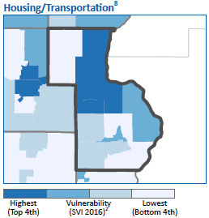
Social Determinant of Health HOUSING/TRANSPORTATION

Slide 10
Social Determinant of Health EDUCATION, ECONOMIC & EMPLOYMENT

Slide 11
Social Determinant of Health EDUCATION, ECONOMIC & EMPLOYMENT

Slide 12
Social Determinant of Health EDUCATION, ECONOMIC & EMPLOYMENT

Slide 13
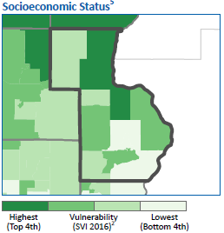
Social Determinant of Health EDUCATION, ECONOMIC & EMPLOYMENT

Slide 14
Social Determinant of Health FOOD ACCESS
# of grocery stores per 100,000 population
% of population with low food access
Chisago County
13
Chisago County
33%
Minnesota
18
Minnesota
28%
Adults Who Worry About Running Out Of Food
‘Sometimes’
‘Often’
7%
4%

Slide 15
Social Determinant of Health FORGONE CARE
Not serious enough
44.2
Deductible too expensive
Cost too much
Copay too expensive Not covered by insurance No insurance
43.7
29.3
Cost related
reasons
14.6
8.2
6.4
Too nervous or afraid
Transportation problems
ould not get appointment
Other
6.1
3
1.6
Did not know where to go
0.5
C
10

Slide 16
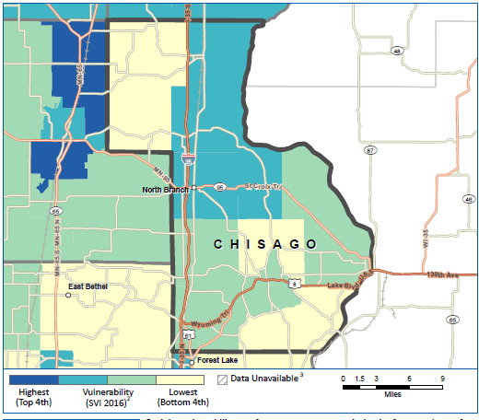
Social Determinant of Health OVERALL VULNERABILITY

Slide 17
Community Health Improvement Plan WHAT IS IT?
Long-term, systematic effort to address public health problems in a community. It is based on the results of community health assessment activities, and is one step in a process to improve community health

Slide 18
Community Health Improvement Plan PRIORITIES
Adverse Childhood Experiences (ACEs)
Mental Health
Food Security
Healthy Weight

Slide 19
QUESTIONS?

